Slide 1
Topics
Review
Server Side Application Logic
PL/SQL Overview
Creating Standalone Procedures (CREATE PROCEDURE)
Passing data to and from a procedure
Anonymous Blocks
Conditional Statements (IF, CASE)
Select Into
Exception Handling

Slide 2
Review
What is achieved by using set operators in SQL statements
Set operators are used to combine or exclude the results of two or more SELECT statement queries into a single result set.
What set operations are available in our versions of DB2 and Oracle?
UNION
UNION ALL
INTERSECT
EXCEPT/MINUS
What set operations are not available in our versions of DB2 and Oracle?
INTERSECT ALL
EXCEPT ALL or MINUS ALL

Slide 3
Review
What are some of the rules when using set operators
The number and order of the columns must be the same
If the type does not match you can use a conversion on the second select column to force a match
If you provide different column names in both queries, is it an error or which one shows?
Where must the order by clause go with the two select statements using a set operator?

Slide 4
Server-Side Application Logic
What is server-side application logic ?
This refers to components of applications which execute locally on the database server
This means the code is executing local to the data used by the application
Why would we want to execute code on the database server ?
Minimize data movement between application location
Client / User environment
Application Server
Leverage data already in memory at the database server location

Slide 5
Server-Side Application Logic
Why would we want to execute code on the database server ?
Massive performance benefits
Leverage optimizations from the database server
Parallelization
Shared-memory
Can be used by any application

Slide 6
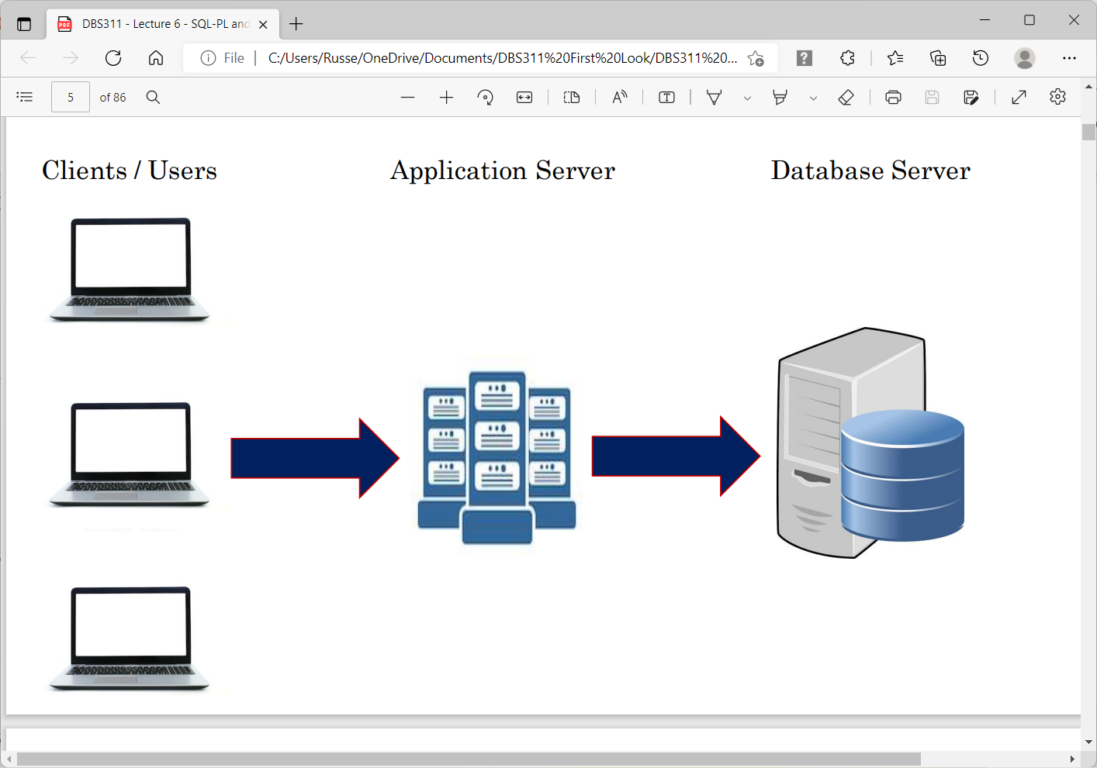
Server-Side Application Logic

Slide 7
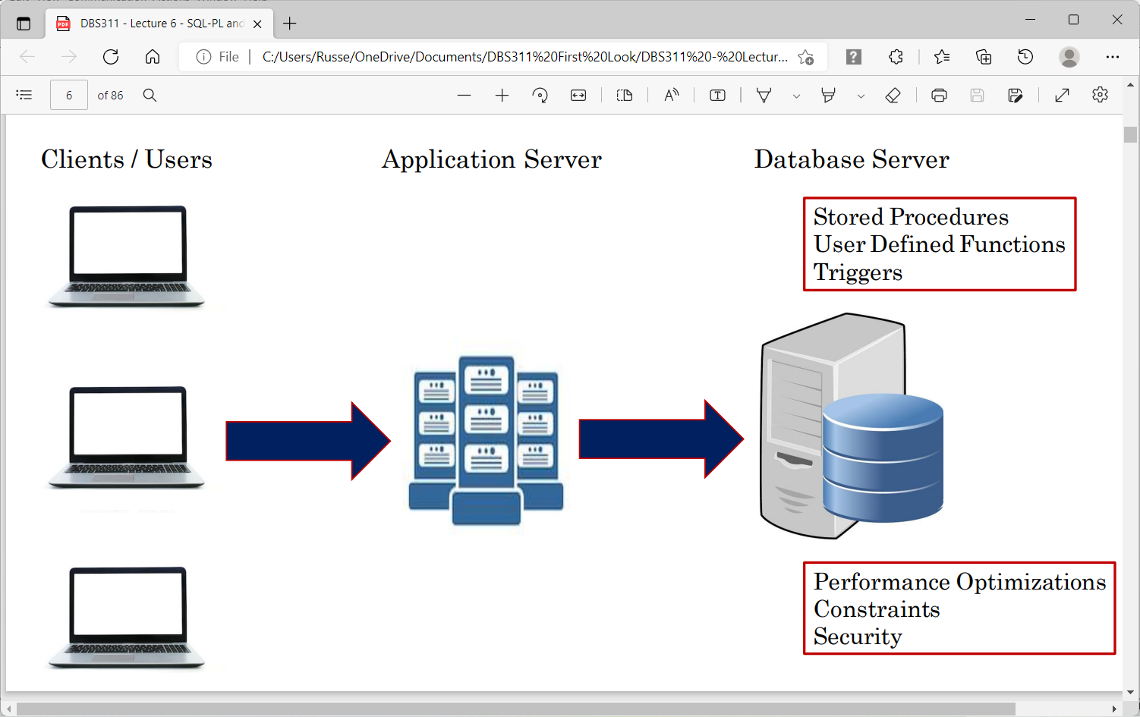
Server-Side Application Logic

Slide 8
Server-Side Application Logic
Stored Procedures
Application modules that perform functions
Execute <Procedure>
CALL <Procedure>
User Defined Function
A function that can be called from SQL
Built-in functions we have already discussed (MIN, AVG, SUBSTR, etc)
Now you can build your own
SELECT FUNC(expression) FROM …..
Trigger
Code to execute when an INSERT, UPDATE or DELETE take place
CREATE TRIGGER ON ……

Slide 9
Server-Side Application Logic
Stored Procedures, User Defined Functions and Triggers can be developed using:
General programming languages (ie: C, Java, etc)
Database specific (native) languages
Oracle (PL/SQL)
Db2 (SQL/PL)
Microsoft SQL Server (Transact-SQL)
SQL PL is actually the SQL ANSII standard language
PL/SQL is what you will use with Oracle
There can be slight differences with what aspects of the stored procedure languages are available in each application object

Slide 10
PL/SQL Overview
PL/SQL is a language with a procedural constructs integrated with SQL that can be used to build complex applications.
PL/SQL is executed in the database.
PL/SQL can be used to create the following program units:
Procedures
Functions
Packages

Slide 11
Creating Procedures/Functions
In Oracle, a program can be written and stored in the database once and be accessed from any application program.
There are two schema level standalone programs:
Procedures
are programs with no returning value
Functions
Are programs with a returning value
When these programs are written and complied in a database they become the schema objects called stored procedures and stored functions.

Slide 12
Procedure/Function building Blocks
Procedures/Functions consists of the following basic PL/SQL block structures:
Declarative (optional)
Variables and constants are identified
Anonymous Block uses keyword DECLARE.
Executable (mandatory)
Contains the application logic. It starts with keyword BEGIN and ends with keyword END.
Exception handling (optional)
Starts with keyword EXCEPTION and handles error conditions that may occur in the executable part.

Slide 13
Procedure/Function building Blocks
Header AS
[declaration statements
...]
BEGIN
...
[EXCEPTION
...]
END;

Slide 14
Create Procedures/Functions
The following is the syntax to create a stored procedure or function:
The keyword OR REPLACE recreates a function or a procedure if it already exists.
Schema is the name of schema that contains the procedure/function
CREATE OR REPLACE PROCEDURE schema.procedure_name
(arg1 data_type, ...) AS
BEGIN
....
END procedure_name;
CREATE OR REPLACE FUNCTION schema.function_name
(arg1 data_type, ...) AS
BEGIN
....
RETURN END function_name;

Slide 15
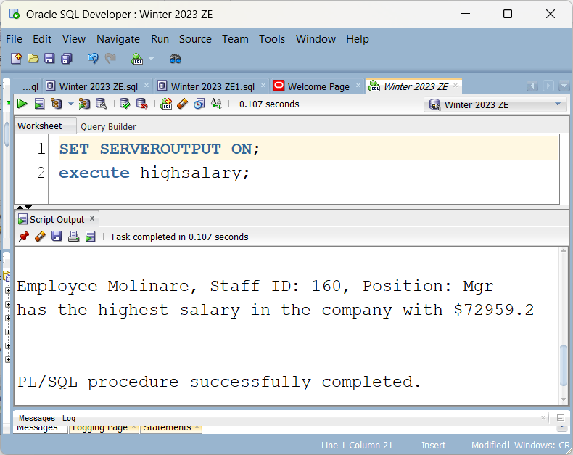
PL/SQL
A working procedure based on STAFF

Slide 16
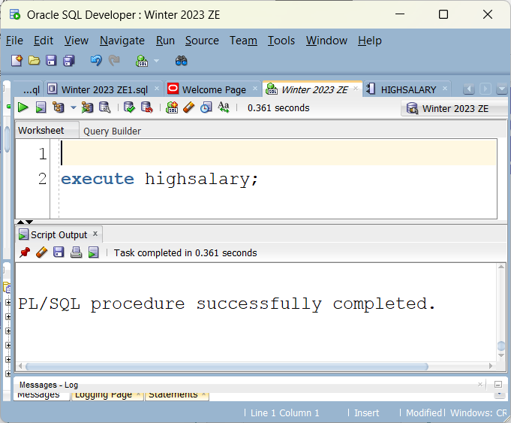
Viewing the output
Without SET SERVEROUTPUT ON;

Slide 17
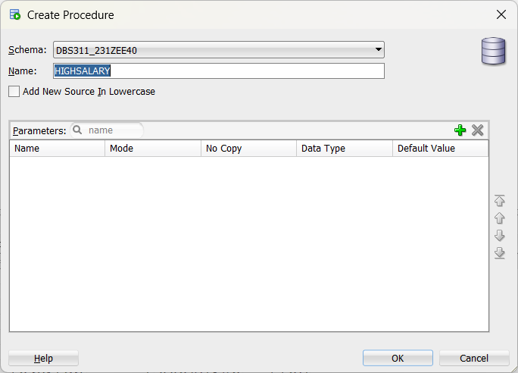
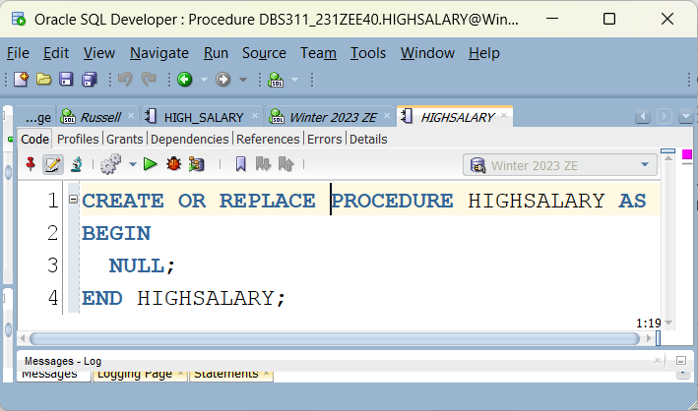
PL/SQL

Slide 18
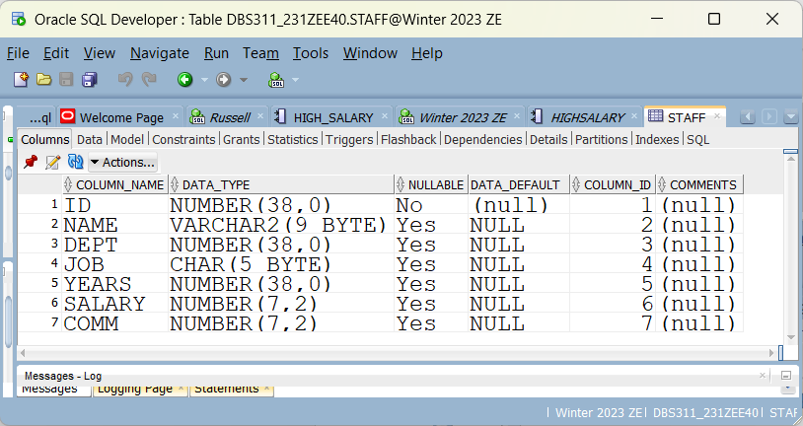
PL/SQL
Variables in procedure should match variables in table

Slide 19
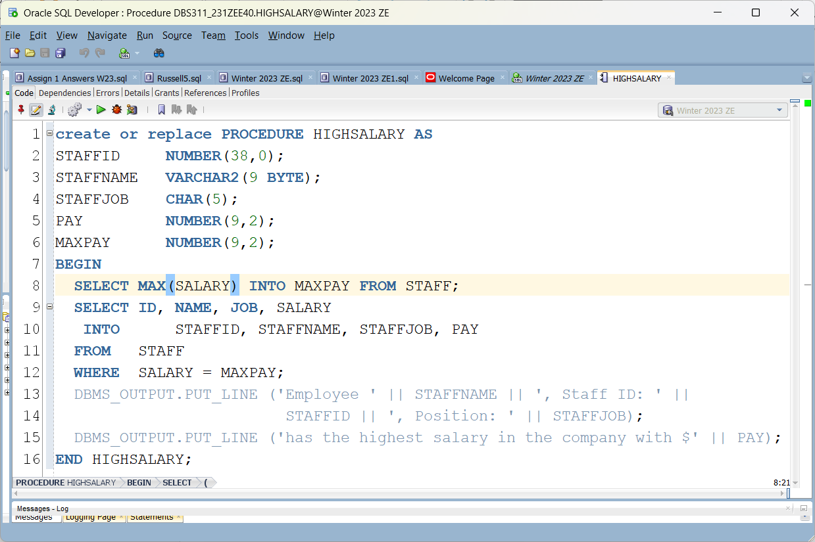
PL/SQL
Solution

Slide 20
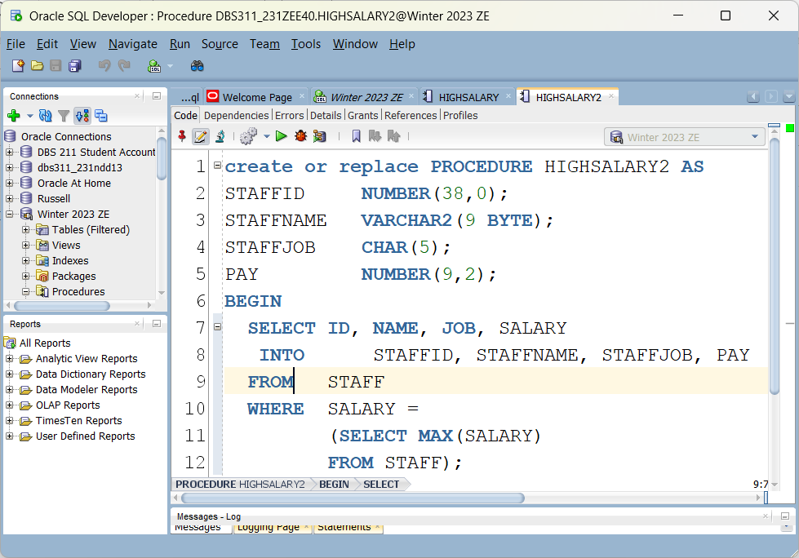
PL/SQL - Different Solution

Slide 21
Arguments in a Procedure/Function
A procedure/function may receive arguments.
An argument has the following elements:
Datatype
Can be any datatype supported by PL/SQL.
1. IN 2. OUT 3. IN OUT
IN indicates that the procedure has to receive a value for the argument.
OUT indicates that the procedure/function passes a value for the argument back to the calling program.
IN OUT indicates that procedure must receive a value for the argument and passes a value back to the calling program.
By default, a parameter is an IN parameter with stored procedures
Using DEFAULT keyword, you can define a value for an argument.

Slide 22
Stored Procedures with Parameters
In PL/SQL, we can pass parameters to stored procedures and functions.
See the following syntax
CREATE OR REPLACE PROCEDURE procedure_name(arg1 data_type, ...) AS
BEGIN
....
END procedure_name;
The following stored procedure deletes the employee with Id given in the stored procedure parameter:
CREATE PROCEDURE RemoveStaff
(STAFFID NUMBER) AS
BEGIN
DELETE FROM STAFF
WHERE ID = STAFFID;
END;

Slide 23
IN Parameters
CREATE PROCEDURE RemoveStaff
(ID IN NUMBER) AS
BEGIN
DELETE FROM STAFF
WHERE STAFF.ID = REMOVESTAFF.ID;
END;
This time IN is specified – not necessary syntactically, but is clearer for readability
This time ID needed to be qualified to differentiate between ID in the staff table from ID defined in the RemoveStaff table this is necessary

Slide 24
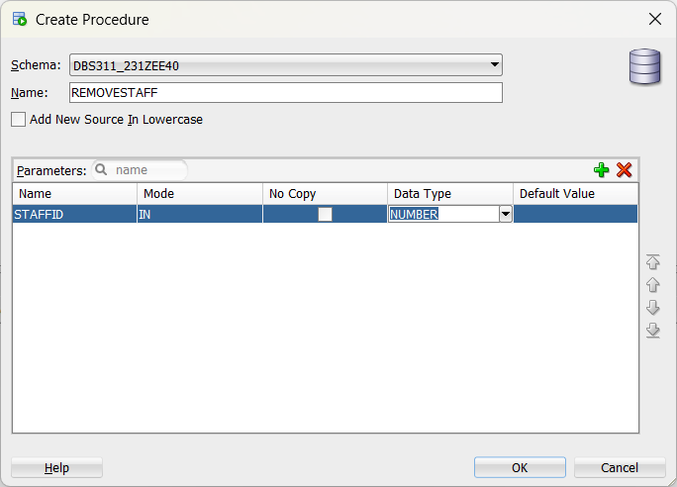
PL/SQL Paramater

Slide 25
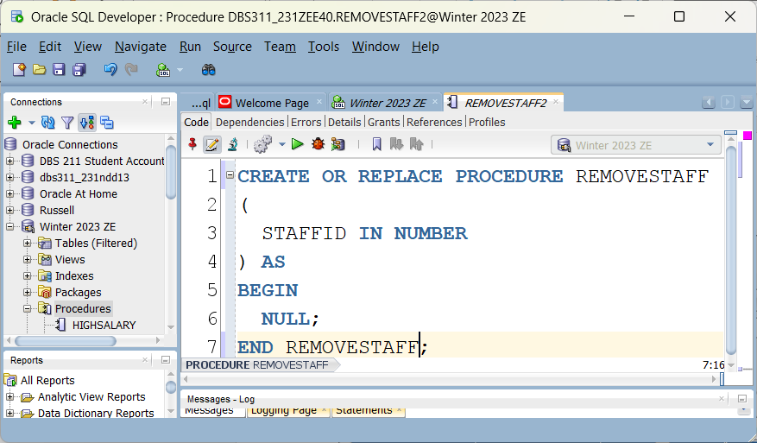
PL/SQL Parameter

Slide 26
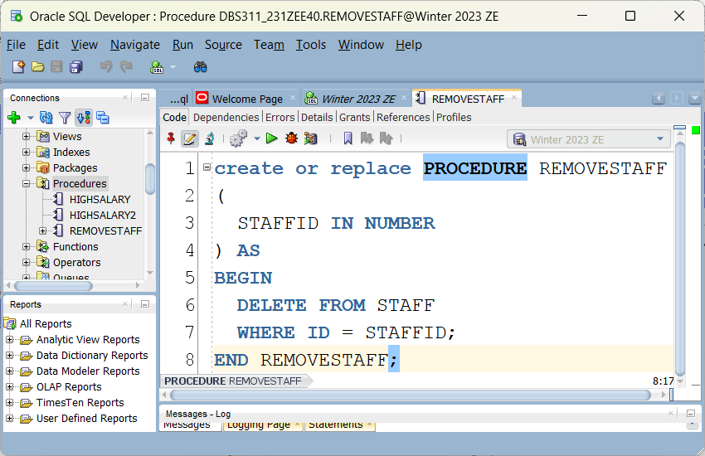
PL/SQL Parameter

Slide 27
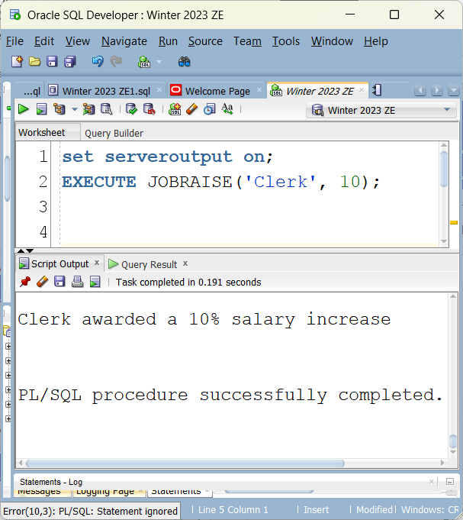
PL/SQL – Multiple parameters

Slide 28
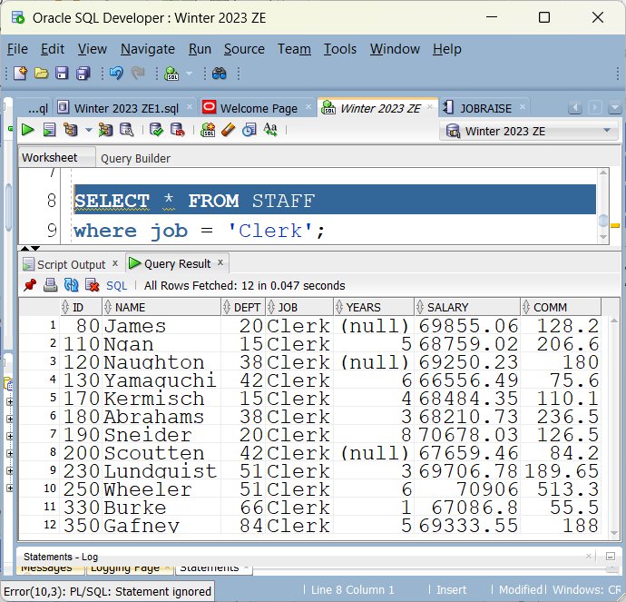
PL/SQL – Multiple parameters
Clerk before the raise

Slide 29
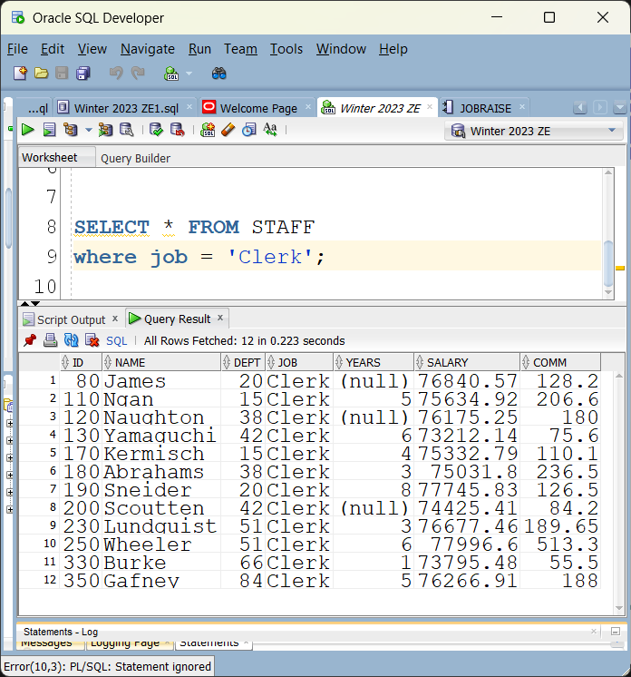
PL/SQL – Multiple parameters
Clerk after the raise procedure run

Slide 30
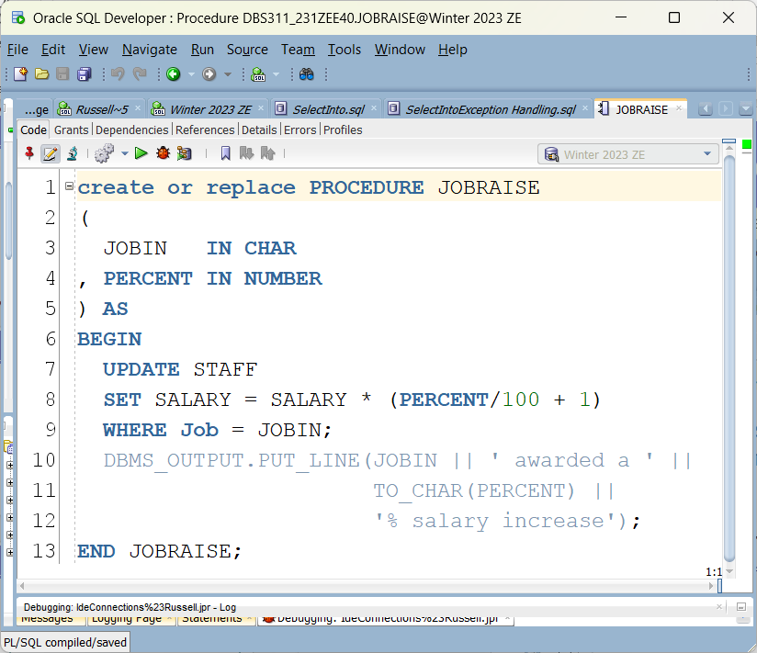
PL/SQL – Multiple parameters

Slide 31
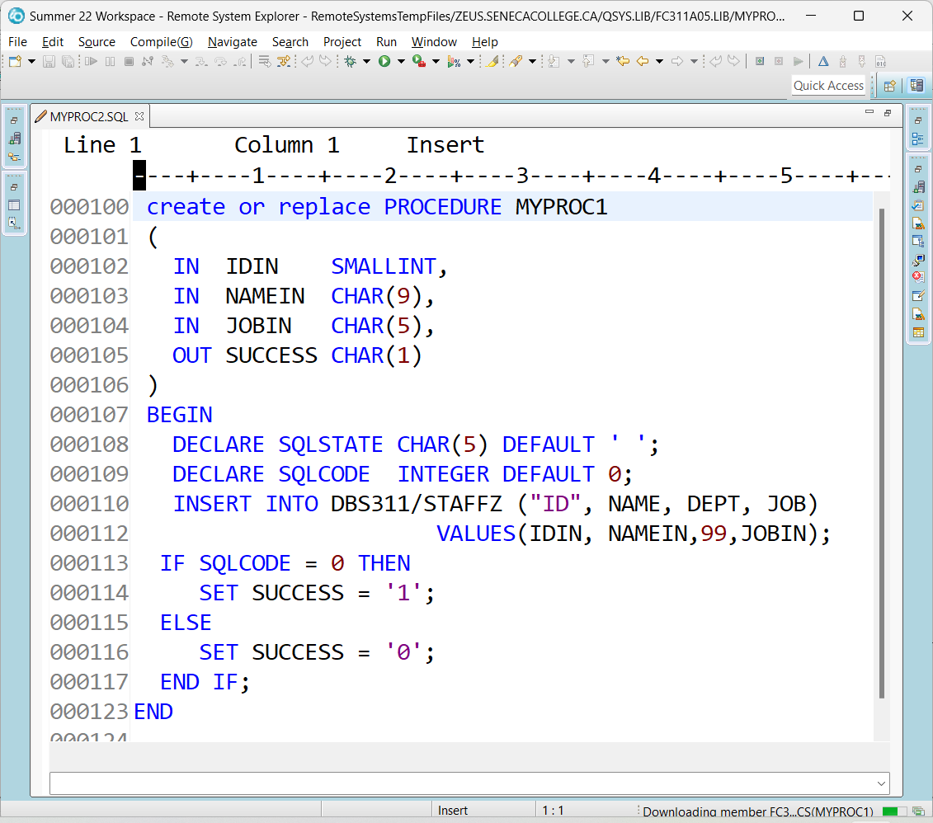
Out Paramater used with SQL/PL (DB2)

Slide 32

Out Paramater used with SQL/PL (DB2)
SELECT * FROM STAFFZ WHERE NAME = 'Pangborn’
CREATE VARIABLE DBS311.SUCCESS CHAR(1) DEFAULT NULL
SELECT DBS311.SUCCESS FROM SYSIBM.SYSDUMMY1
Set up debug mode for procedure
call myproc1(444,'Pangborn','Prof',DBS311.SUCCESS)

Slide 33
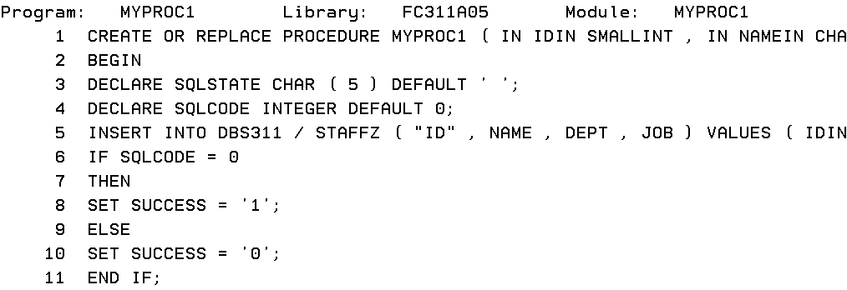
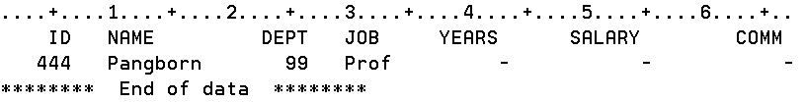
Out Paramater used with SQL/PL (DB2)
Stepping through procedure
After procedure finishes

Slide 34

Out Paramater used with SQL/PL (DB2)
SELECT DBS311.SUCCESS FROM SYSIBM.SYSDUMMY1

Slide 35
PL/SQL Anonymous Blocks
A block without a name is an anonymous block.
An anonymous block is not saved in the Oracle Database server, so it is just for one-time use. However, PL/SQL anonymous blocks can be useful for testing purposes.
You can save the SQL code as a file on your local machine.

Slide 36
PL/SQL Anonymous Blocks
BEGIN
DBMS_OUTPUT.PUT_LINE (‘Welcome to DBS311!’);
END;
To see the output:
Execute the following statement first:
SET SERVEROUTPUT ON;
To execute the block, in your SQL developer worksheet, select the block and press the run bottom:
Output:
Welcome to DBS311!
PL/SQL procedure successfully completed.

Slide 37
Procedure vs Anonymous Block
CREATE OR REPLACE PROCEDURE NOTANONYMOUS
AS
BEGIN
DBMS_OUTPUT.PUT_LINE('WELCOME TO DBS311');
END;
This is a permanent database object on the server, not a file on your PC
EXECUTE NOTANONYMOUS;
Welcome to DBS311
To remove the database object
DROP PROCEDURE NOTANONYMOUS;

Slide 38
Out Paramater used with PL/SQL (Oracle)
Will test procedure (saved object) with anonymous block (saved file)
Procedure (saved object)
create or replace PROCEDURE count_staff (staff_count OUT NUMBER) AS
BEGIN
select count(*) INTO staff_count
from staff;
END;
After procedure finishes

Slide 39
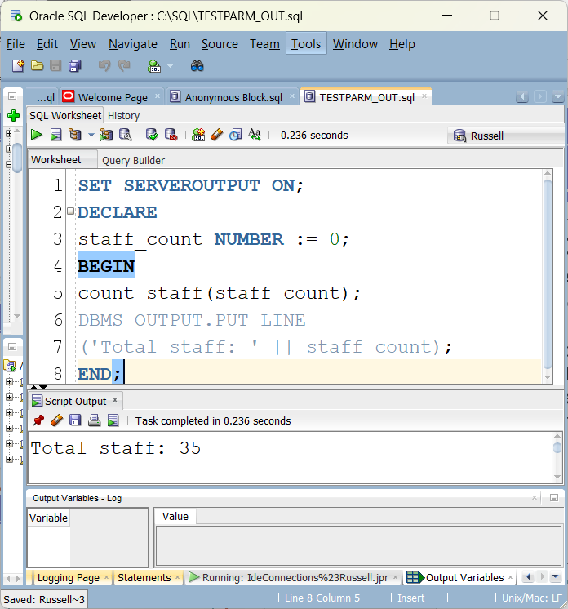
Out Paramater used with PL/SQL (Oracle)
Anonymous Block (saved file)

Slide 40
IN OUT Parameters
CREATE OR REPLACE PROCEDURE procedure_name(arg1 IN OUT data_type, ...) AS
BEGIN
....
END procedure_name;
The following procedure gets a salary and increases the salary by 20%
CREATE OR REPLACE PROCEDURE new_salary (salary IN OUT FLOAT) AS
BEGIN
salary := salary * 1.20;
END;
DECLARE salary FLOAT := 10000;
BEGIN
new_salary (salary);
DBMS_OUTPUT.PUT_LINE (salary);
END;
RESULTS IN 12000

Slide 41
SQL/PL (DB2)
Using Debug to investigate IF ELSE ELSEIF statements

Slide 42
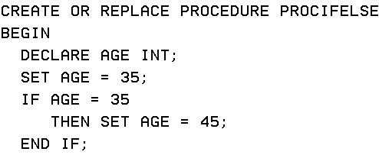
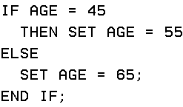
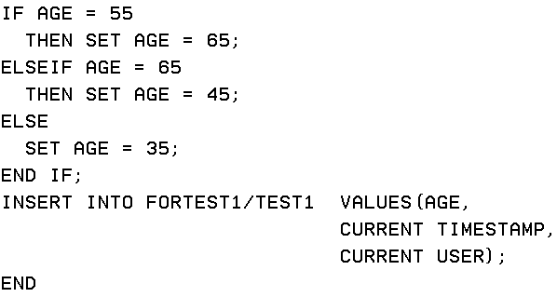

Slide 43
What is age?
Look at STRDBG

Slide 44


SQL/PL (DB2)

Slide 45
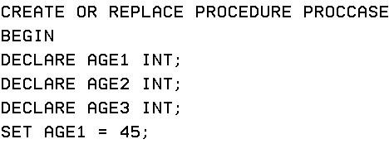
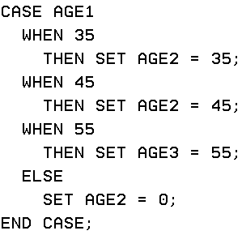
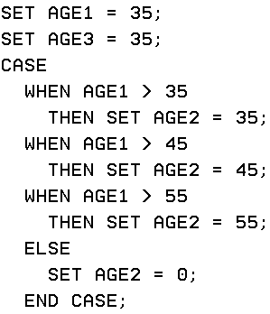

Slide 46
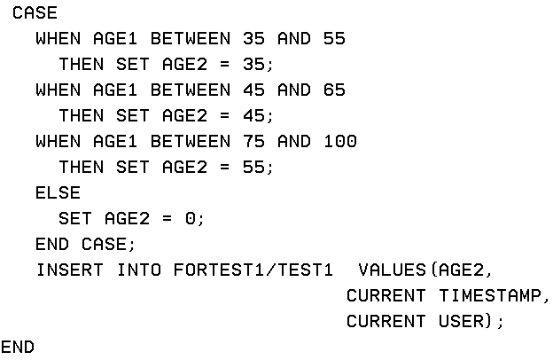
Case continued

Slide 47


SQL/PL (DB2)

Slide 48
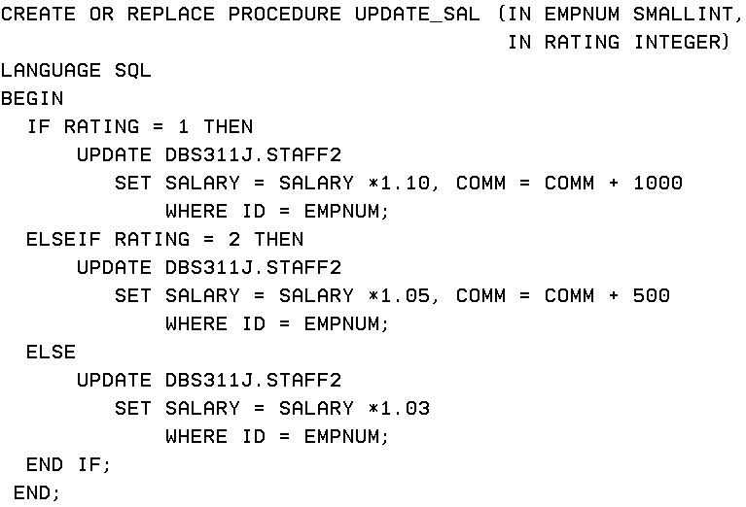
SQL/PL (DB2)

Slide 49
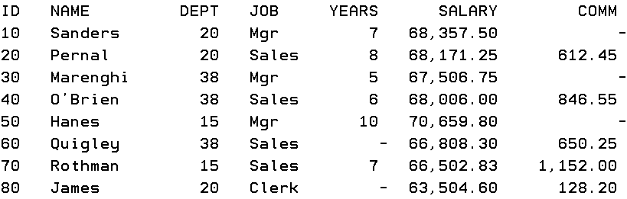
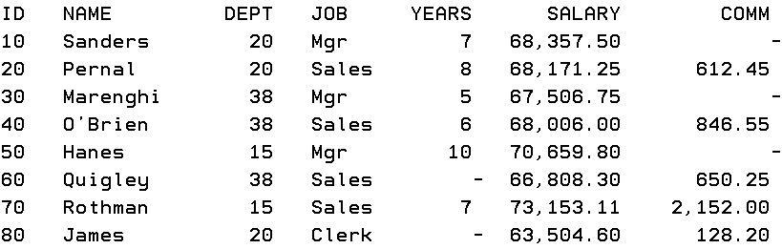

Slide 50
PL/SQL (Oracle) Exception
Exception part handles the errors occurred during the execution of a PL/SQL block.
DECLARE
value_1 NUMBER := 20;
value_2 NUMBER := 0;
division NUMBER
BEGIN
division := value_1 / value_2
DBMS_OUTPUT.PUT_LINE ('division: ' || division);
The execution of the above code stops with an error. See the following output:
Error report:
ORA-01476: divisor is equal to zero ORA-06512: at line 8
01476. 00000 - "divisor is equal to zero"

Slide 51
Exception Handling
To handle the exception errors, we use EXCEPTION section. WE add this section to handle the error in the code from previous slide:
EXCEPTION
WHEN OTHERS
THEN
DBMS_OUTPUT.PUT_LINE ('Error!');

Slide 52
SELECT INTO
IN PL/SQL, you can use SELECT INTO statement to store data from a single row fetch by a SELECT statement.
SELECT column_list
INTO variable_list
FROM table_name
WHERE condition(s);
TOO_MANY_ROWS exception
An exception will occur if the SELECT statement returns more than one row.
NO_DATA_FOUND exception
An exception will occur if the SELECT statement returns no data.

Slide 53
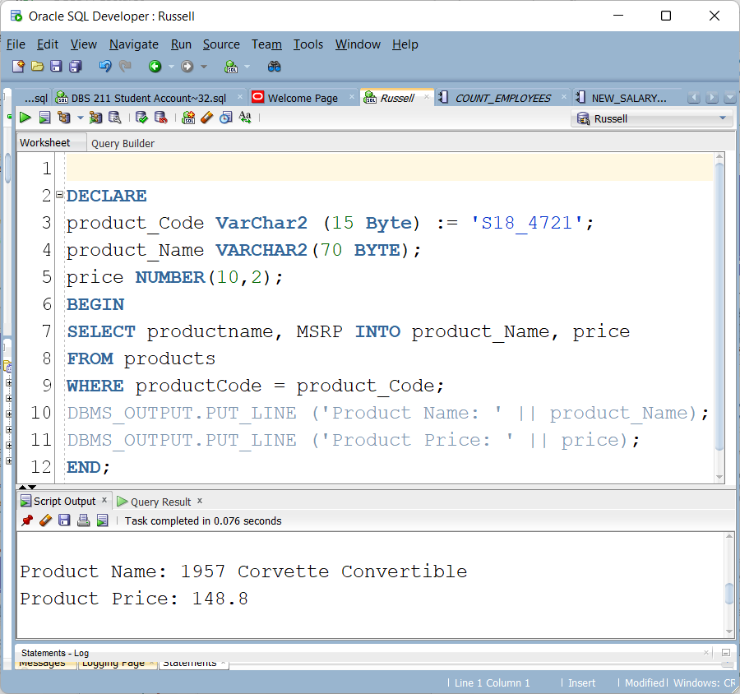
SELECT INTO (Example)

Slide 54
TOO_MANY_ROWS Exception
In SELECT INTO statement, an exception occurs if the result of the fetched data includes more than one row.
We change the condition to
WHERE productCode > product_Code;
Since, we have many rows greater than the inputted product code, the SELECT INTO statement fetches more than one row and raised an exception.

Slide 55
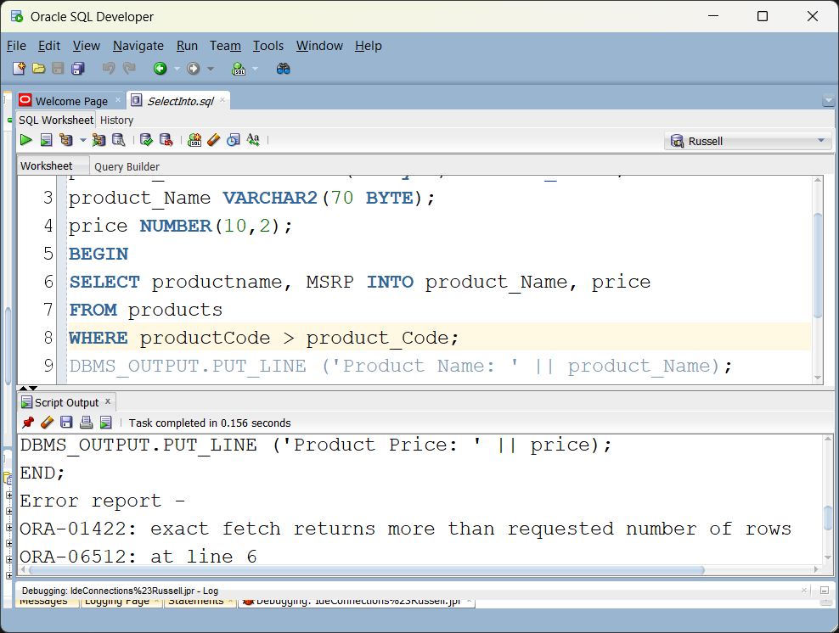
TOO_MANY_ROWS Exception

Slide 56
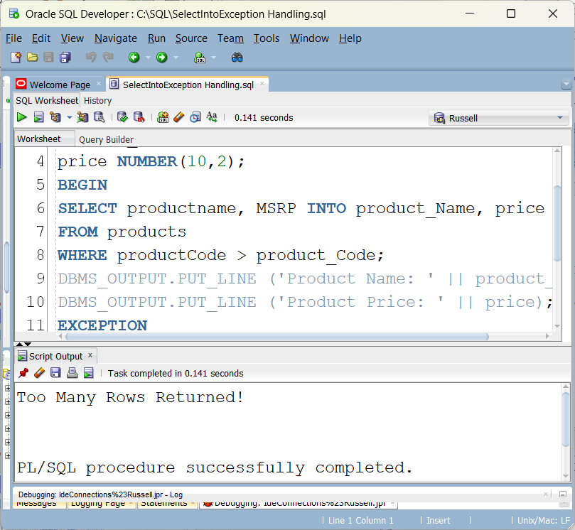
TOO_MANY_ROWS Exception

Slide 57
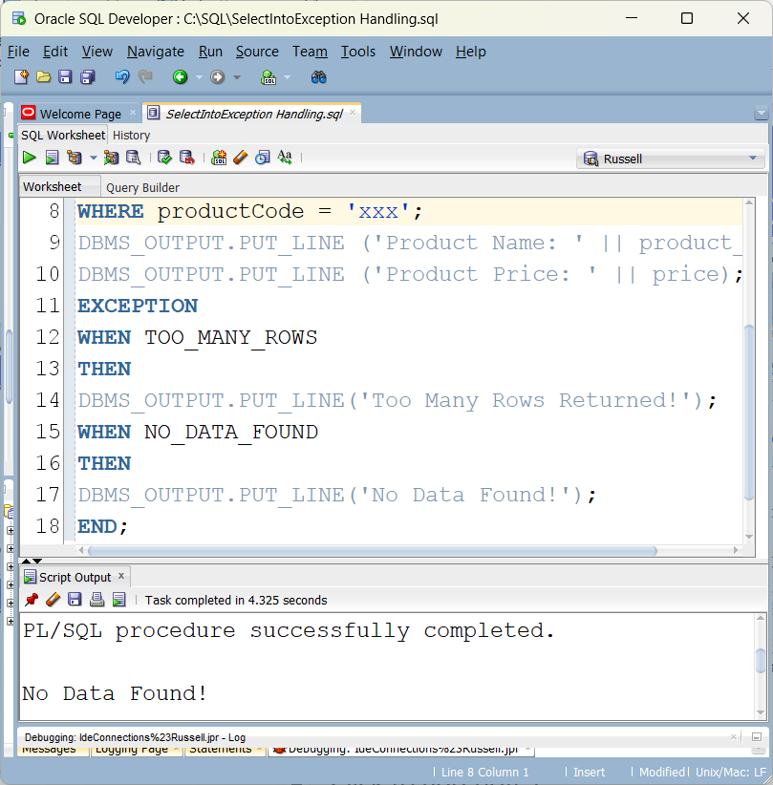
NO_DATA_FOUND Exception

Slide 58
Lab 5
Lab 5 will be an Oracle lab
It is not due until after reading week
Will be posted before reading week starts

